Slide 1
Parkinson’s Disease:
Living With and Managing
Motor and Non-motor Symptoms
Cheryl Siefert, Executive Director
csiefert@parkinsonrockies.org
www.parkinsonrockies.org

Slide 2
What is Parkinson’s Disease
Movement Disorder
Occurs when Dopamine is lacking within the brain
Affects over 1 Million Americans – 17,000 in CO
Average age of diagnosis early 60’s
Can be as early as 20’s, 30’s and 40’s

Slide 3
Symptoms
To be Parkinson’s Disease MUST HAVE
Bradykinesia – slow movement

Slide 4
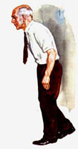
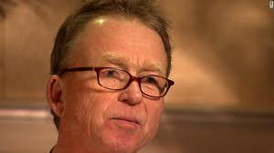
Motor Symptoms in PD
Tremors: resting - begin on one side of body
Poor Gait and Balance
Leaning Forward
Shuffling or Running Walk
Falling – generally forward
Rigidity - Ratcheting
Masked Face
Notes:
Think Pink Panther.
Have trouble turning around.
Balance and posture problems may result in frequent falls. But these problems usually do not develop until later in the course of the disease.

Slide 5
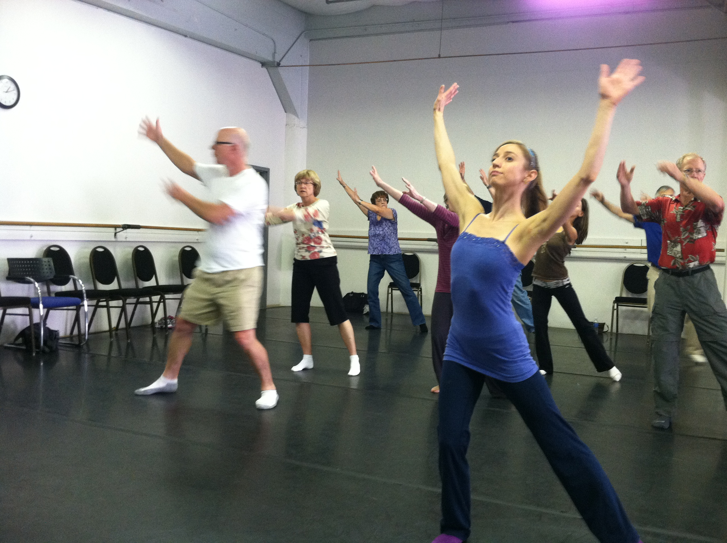
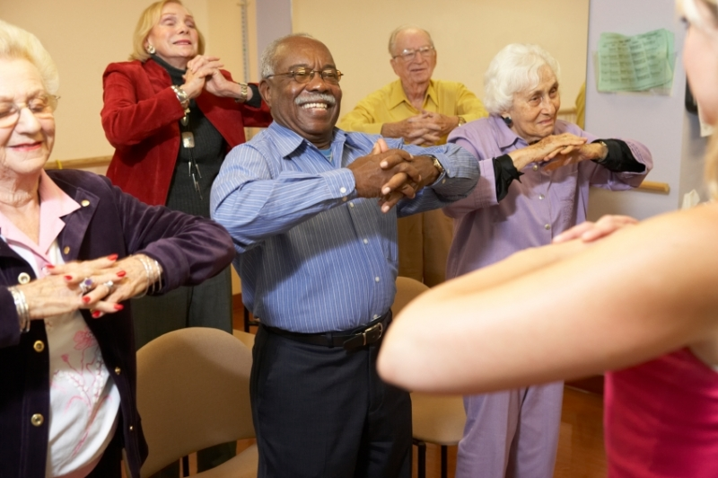
Exercise the Essential Treatment

Slide 6
why Exercise is the best medicine
SLOWS DOWN the progression of PARKINSON’S DISEASE

Slide 7
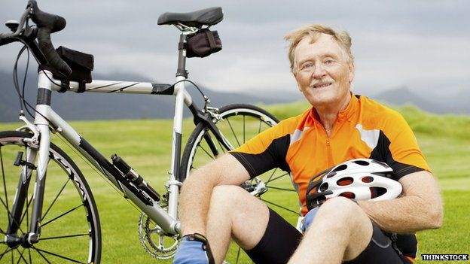
How Much and what type of exercise
Exert yourself – to raise heart rate and break a sweat
Minimum recommended: 30 minutes/day 5 days/week

Slide 8
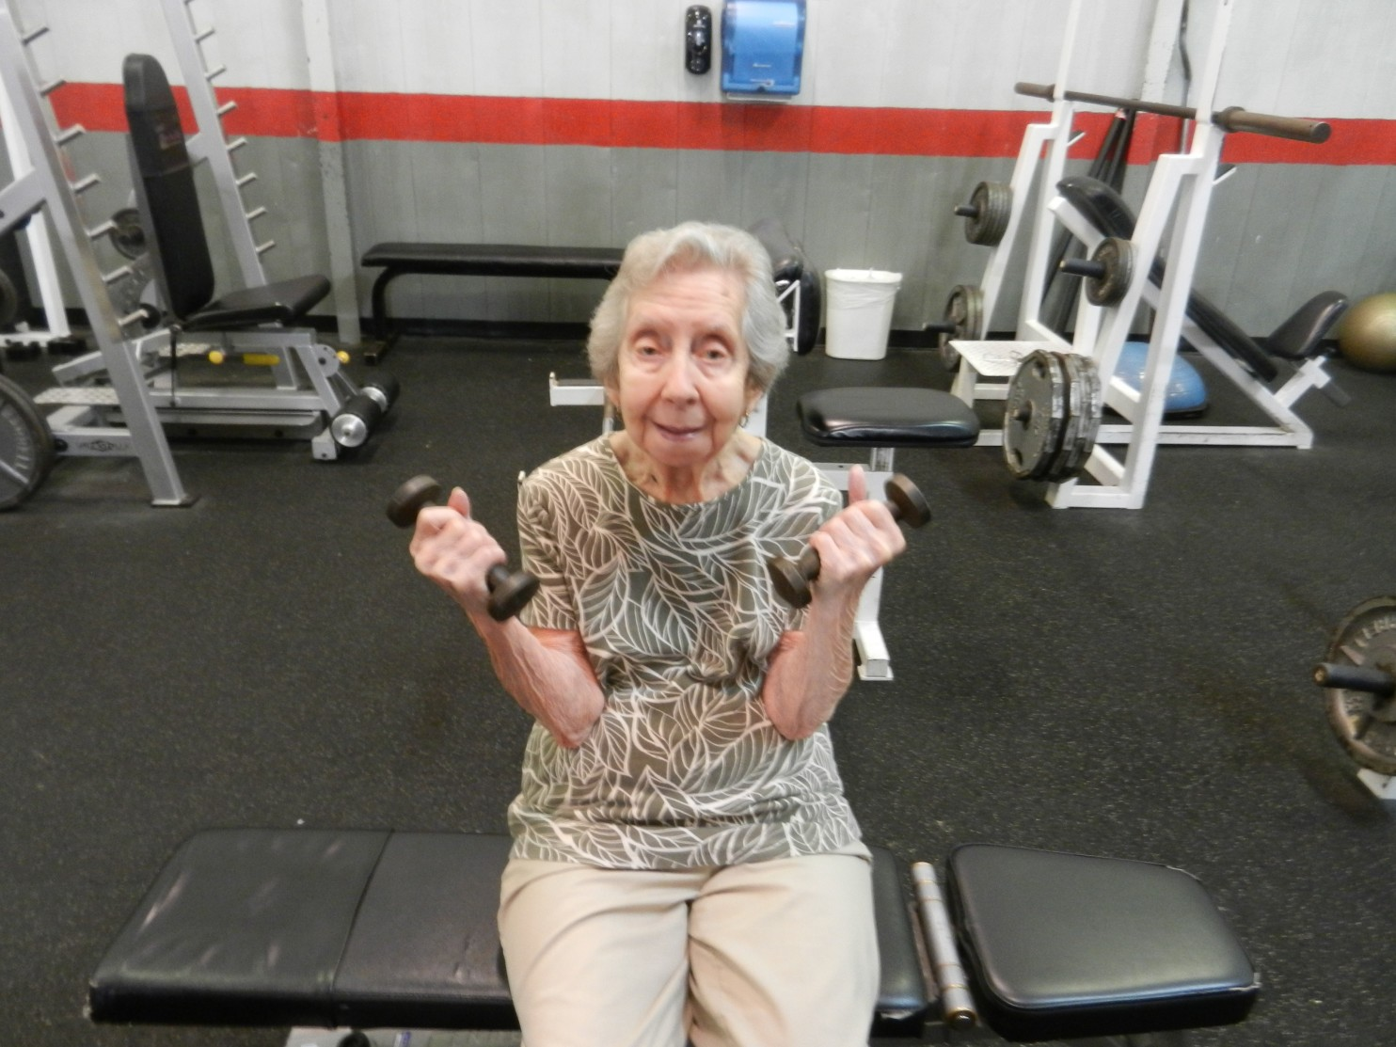
Just Get started!
DO NOT compare yourself to others.
DO compare what you did yesterday to what you plan to do today.
Stretch yourself until you reach your goal

Slide 9
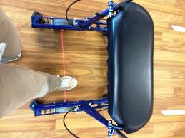
FREEZING - Stuck in Place
Usually occurs in small spaces such as doorways or in large crowds when anxious or stressed.
Tips and Tools
Audio Cues
Visual Cues
Movement tricks
Adaptive Equipment

Slide 10
MOTOR SYMPTOMS
Bradykinesia
Tremor
Rigidity
Gait Imbalance
NON-MOTOR SYMPTOMS
Urinary frequency
Dementia
Depression/Anxiety
Psychosis
Apathy
Drooling
Sexual dysfunction
Runny nose
Fatigue
Constipation
Orthostatic hypotension
Pain
Insomnia
Decreased sense of smell
Restless Leg Syndrome
Nausea/Vomiting

Slide 11
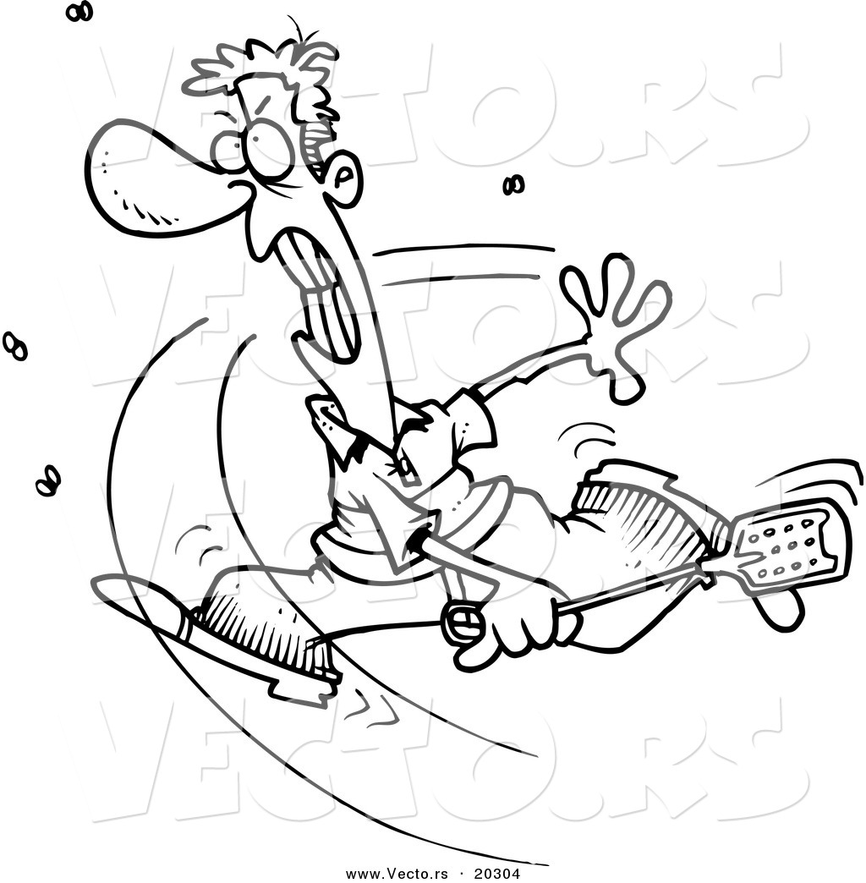
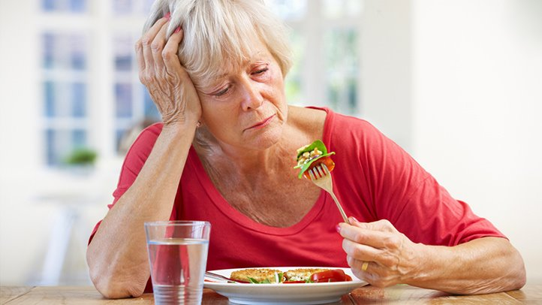
Non-Motor Symptoms of PD
Under-recognized and under-treated
Often more irritating than motor symptoms
Loss of sense of smell is often the first symptoms of PD
Leads to decreased appetite
No treatment

Slide 12
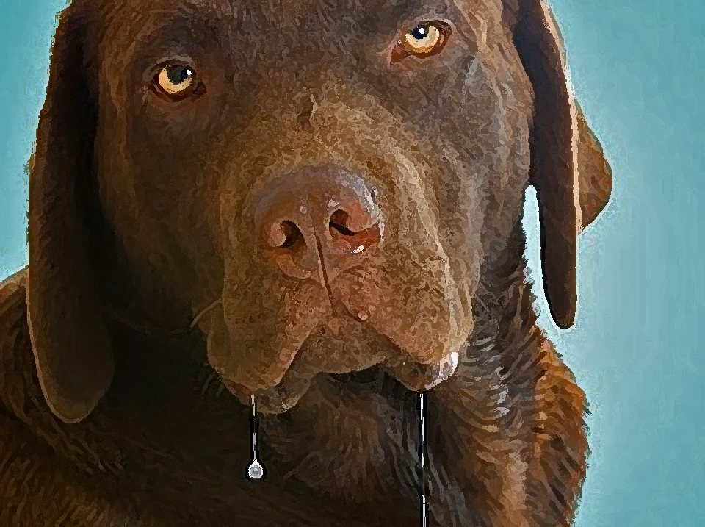
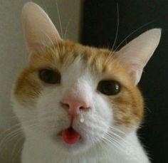
Drooling and runny noses
Not an overproduction of saliva, due to impaired mouth movements and swallowing
Embarrassing, can cause choking or aspiration
Tips that may help drooling
Suck on hard candies or chew gum
Atropine drops on tongue – consult physician
Botox injections – last resort
Try treating runny nose with Atrovent nasal spray - Consult physician

Slide 13
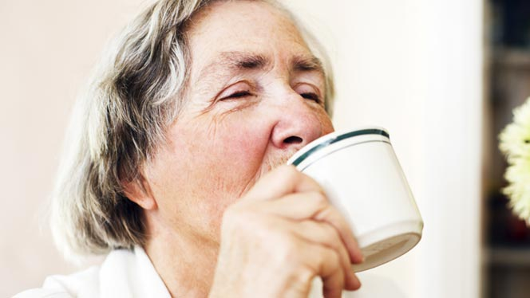
Speech and Swallowing Difficulty
Slowness of movement of the mouth, throat and respiratory muscles
Can lead to soft voice, malnutrition, aspiration pneumonia
Tips for speech:
LSVT Therapy
Big and Loud,
Singing
Tips for swallowing:
Small bites and sip water after every bite. Avoid straws
Consult physician for swallowing evaluation

Slide 14
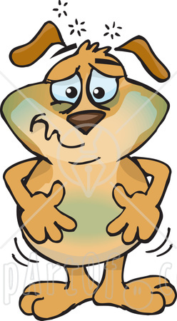
Constipation
Often an early sign of Parkinson’s
Slow muscle movement
Treatment:
Exercise
Diet
Adequate hydration – at least 64 oz/day of water
Increased fiber – bran, prunes
Regular physical activity gets bowels moving
Medications – consult physician

Slide 15
Dehydration Remember – 64 oz.
Parkinson’s medications can raise the risk for dehydration.
Due to lack of mobility, people with Parkinson’s drink less frequently.
Symptoms are weakness, balance problems, confusion, kidney and respiratory failure.

Slide 16
Non-Motor Symptoms Neuropsychiatric
Anxiety
Fatigue
Depression

Slide 17
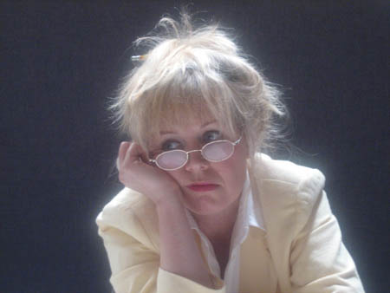
Treatment for neuropsychiatric symptoms in parkinson’s
Exercise
Mindfulness and meditation
Check for medication side affects hallucinations
Medications - consult physician

Slide 18
Impulse Control Disorders
Increase in compulsive or impulsive behaviors
Shopping, gambling, binge eating, cleaning, hypersexuality
Punding – repetition of useless tasks, like organizing objects
Often caused by medication
Decrease or change medication

Slide 19
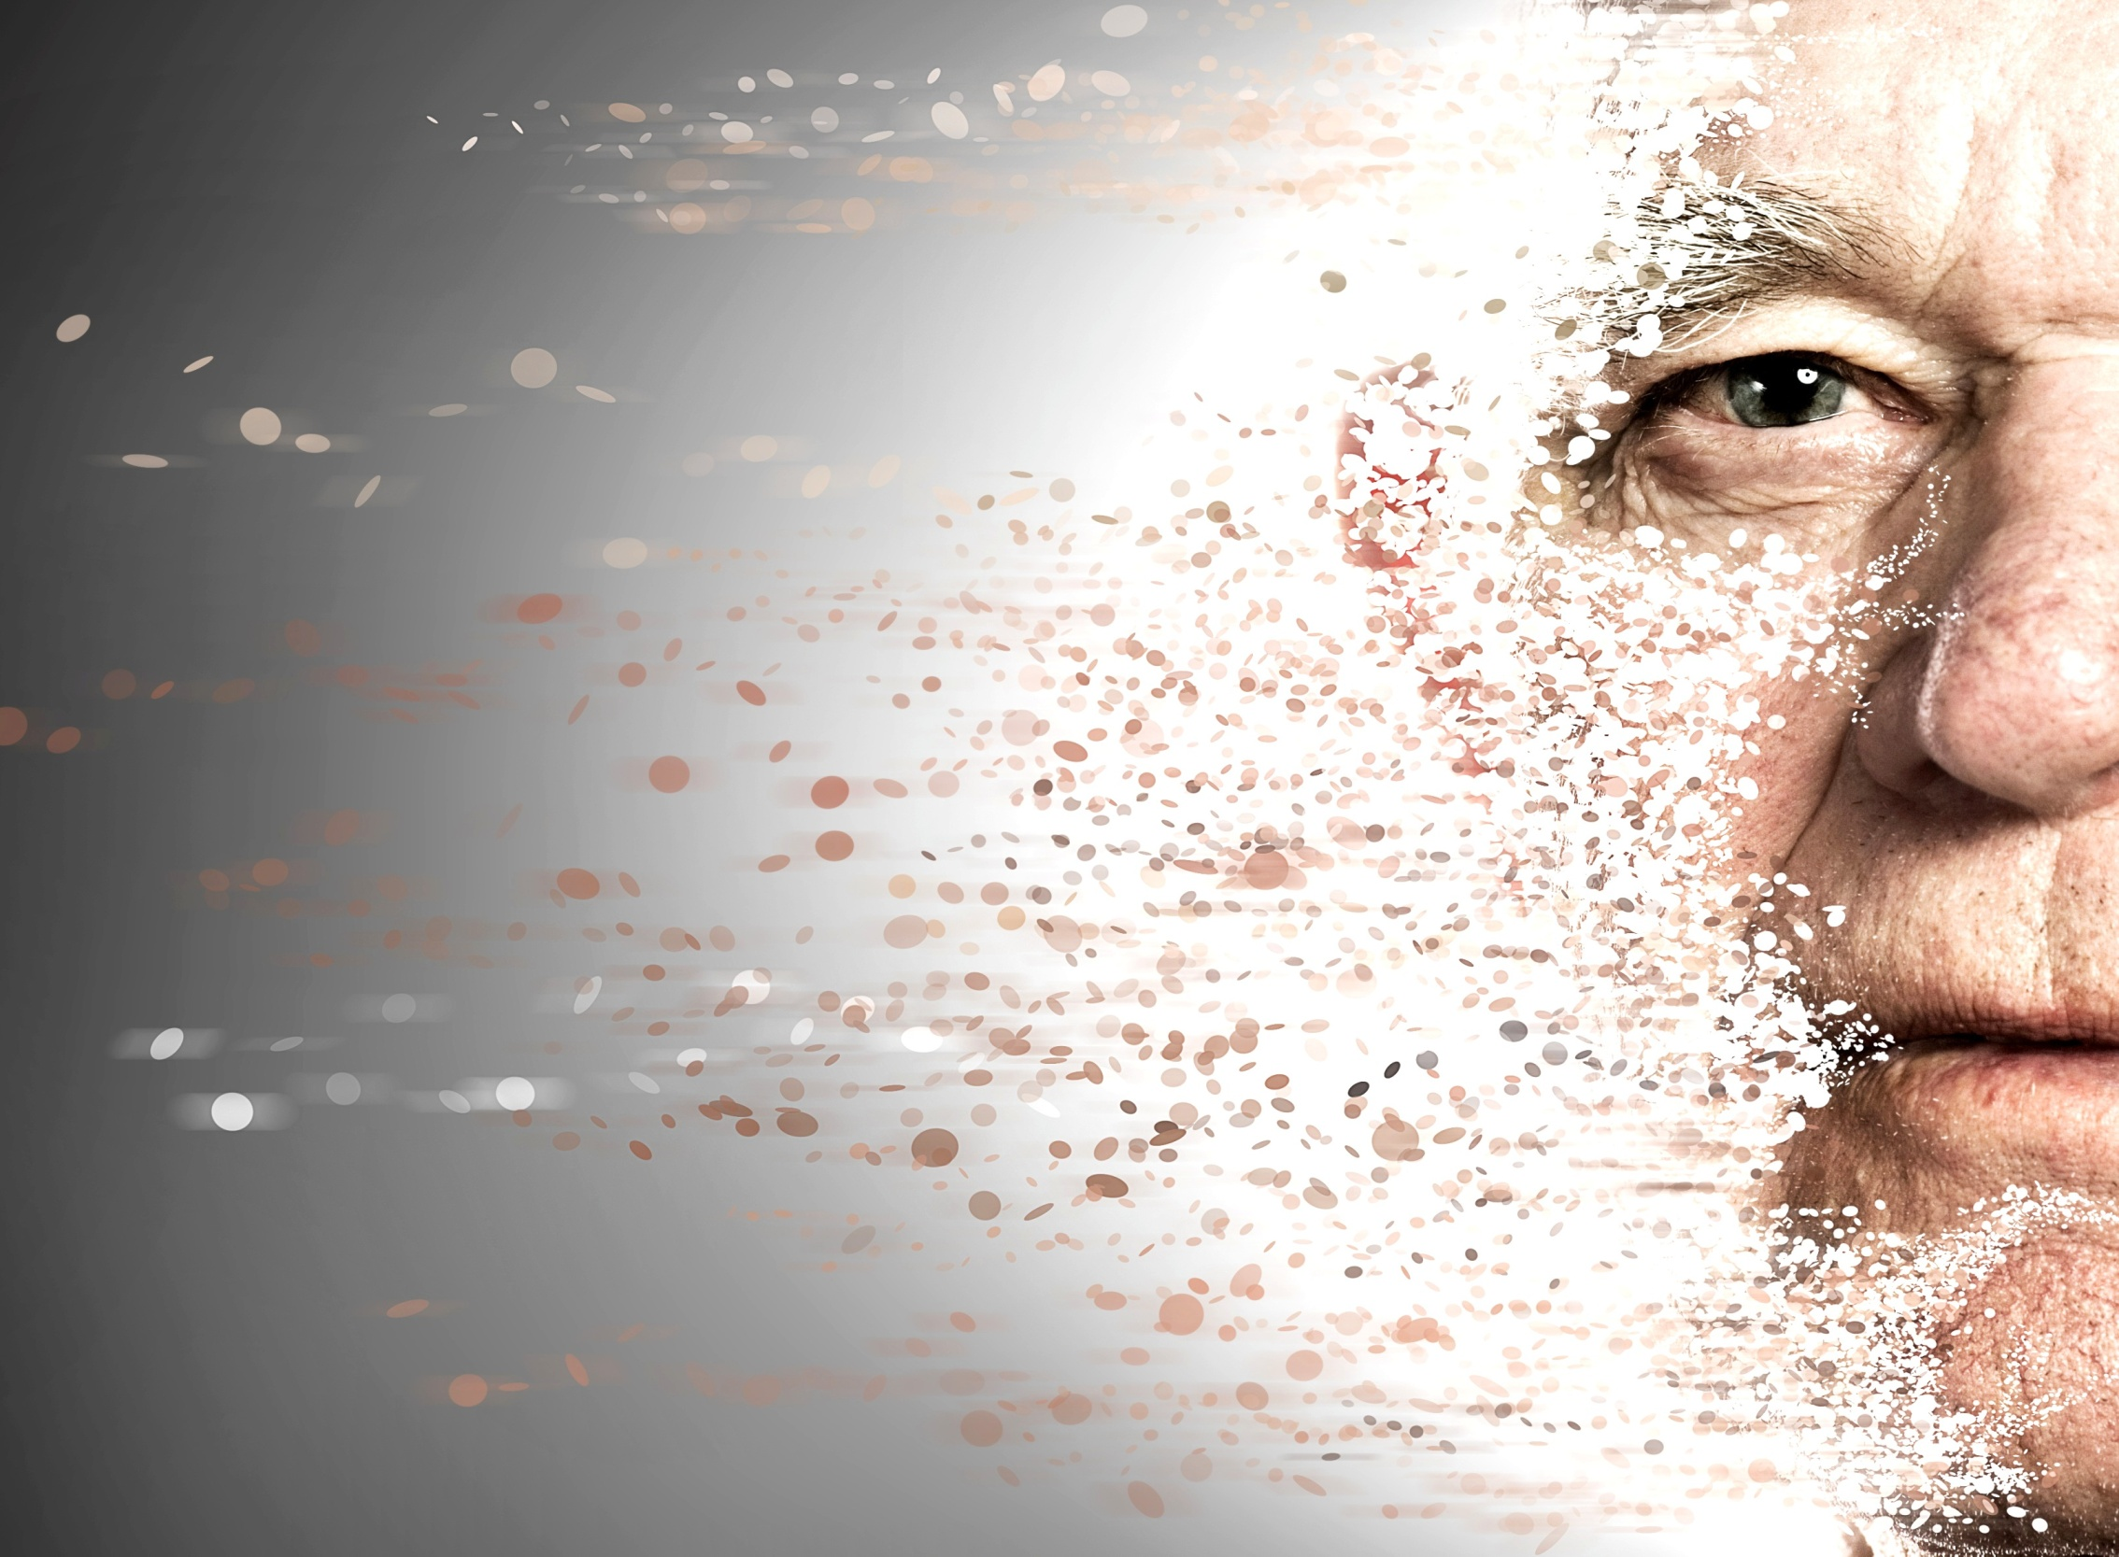
Types of Cognitive Changes
Normal Age Associated Impairment
Environmental / Personal
Medications
Brain

Slide 20
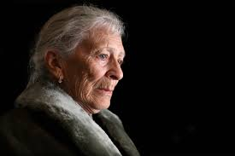
Cognitive Changes in PD Just the Facts
40 - 80% of individuals with Parkinson’s develop dementia
3 – 6x more likely in elderly patients w/PD then in younger
Parkinson’s Disease Dementia and Lewy Body Dementia most common

Slide 21
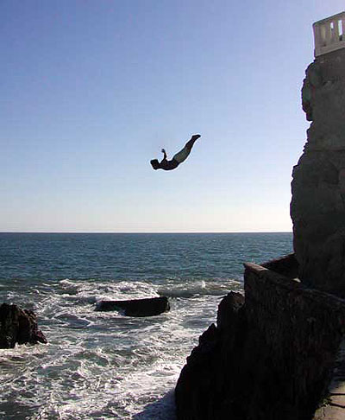
NO CURE DO NOTHING
What to do – to help Parkinson’s from affecting your mind
BE TENACIOUS
BE PROACTIVE

Slide 22
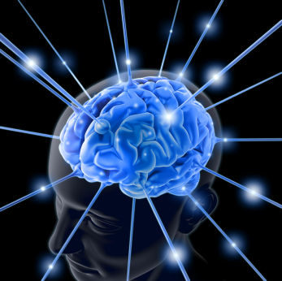
WAYS TO HELP THE BRAIN
Social Engagement
Proper feeding and watering
EXERCISE – PHYSICAL & MENTAL
Support groups
Meds: Donepezil, rivastigmine, memantine
Supplements – Reminder ALWAYS check with doctor
Memory boosting supplements – few good studies to prove or disprove effectiveness
CoQ10 – naturally occurs in body / low in people with Parkinson’s
Ginkgo Biloba – can cause bleeding
St. John’s Wart – DO NOT USE as it interfers with dopamine uptake.
Medications to avoid – www.awareincare.org
Notes:
B12 and folic acid can combat high homocysteine levels common when taking levodopa

Slide 23
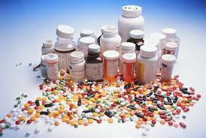
HOW PARKINSON’S AFFECTS MEDICAL CARE
Your doctor is your partner NOT your boss
MEDICATION & HEALTHCARE MANAGEMENT
Discuss changes in meds, changes in response to meds, and other physical changes bothering you.
Keep a journal
Remind others MEDS MUST BE TAKEN ON TIME
Ask doctor to notify other doctors of treatments and changes
When possible, consult a Movement Disorder Neurologist
Get an Aware in Care kit at www.awareincare.org

Slide 24
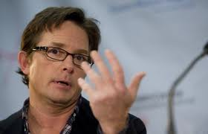
Wisdom
“As we await the discoveries, we have the human spirit”

Slide 25
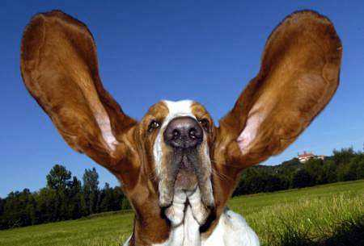
IT’S THE ATTITUDE

Slide 26
Enhancing Lives - Connecting Communities
Cheryl Siefert, Executive Director
csiefert@parkinsonrockies.org
www.parkinsonrockies.org

